Slide 1
Notes:
“Hi and welcome to Class Chats! We are so excited that you have decided to become a Class Chat Volunteer with Amazon Future Engineer!”

Slide 2
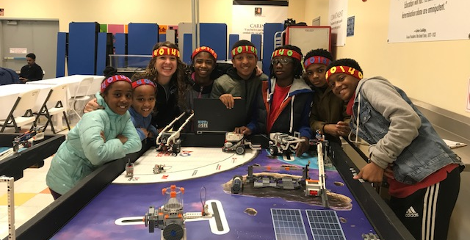
Hilah Barbot
Sr. Product Manager
barhilah@amazon.com
Former Science and Computer Science Teacher & FIRST Lego League Coach
Notes:
Now that you know a little bit about hercules, let me start out by giving everyone some background about Amazon Future Engineer.

Slide 3
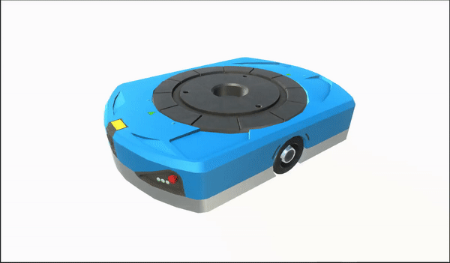
Warm Up: Meet Hercules
1,250
I can lift _________ pounds.
200,000
There are currently _________ of me working to fulfill customer orders.
The Amazon Robotics team filed for _________ patents during my creation.
7
Notes:
Before we begin, I want you to meet today’s very special guest – Hercules! Hercules is an amazon robot who helps make sure customers get their order as fast as possible and I want you to know some cool facts about him. Please get your chat boxes ready. I am going to introduce a stat to you and I want you to guess the number!!! Who ever’s closest wins!

Slide 4
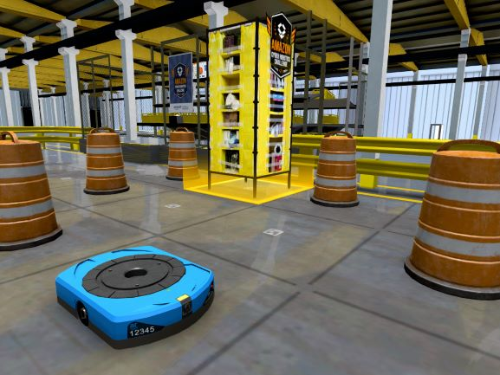
Goals for Today:
Participants will get to know Amazon Future Engineer and walk away with free curriculum and tools to use in your classroom:
Code.org and Edhesive Curriculum
Student Scholarship
Teacher of the Year
Explore activities: Class Chats, Your Voice Is Power, Cyber Robotics Challenge + CoderZ
Coming Soon: Virtual FC Tours!

Slide 5
is a social impact team at Amazon aimed at increasing access to computer science education to underrepresented communities in tech.
Notes:
“Before we begin, I do want to do a brief recap of WHY we are all here. So first off, what is Amazon Future Engineer? AFE is a social impact team at Amazon aimed at increasing access to computer science education to underserved and underrepresented communities in tech.”

Slide 6
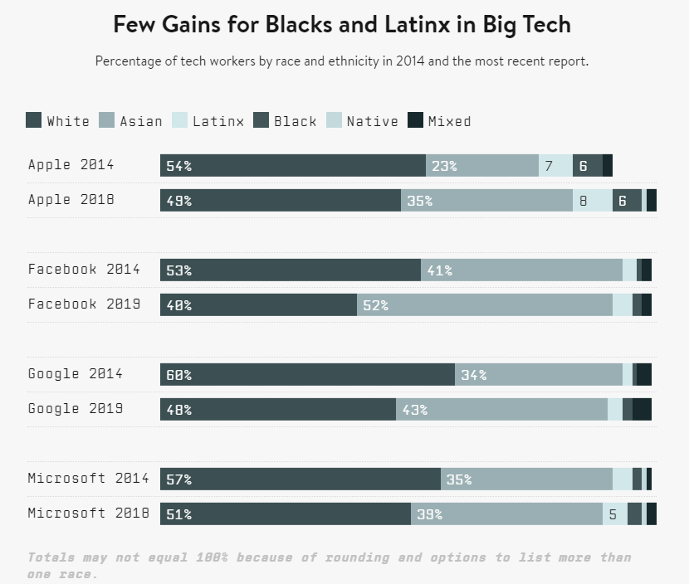
Access to computing careers is not equitable across all demographics and communities.
Notes:
“As we all know, access to computing careers is not equitable across all demographics and communities. Even despite big pushes in top tech companies to diversify their work force, we haven’t seen major change happen in the past 5 years.”

Slide 7
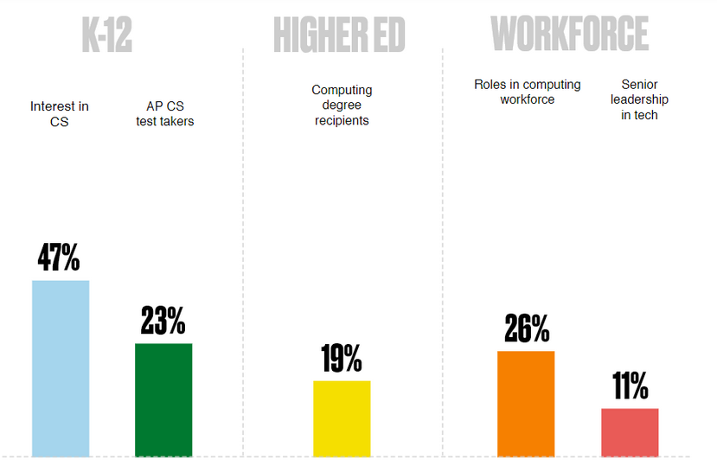
Women, especially women of color, are chronically underrepresented at every stage of the tech journey.
Notes:
“And this problem spans both race and gender where we see that women are also chronically underrepresented in tech careers.”

Slide 8
Free CS Courses and Teacher Training
We fund CS courses in 5,000 Title 1 K-12 classrooms across the US.
Teacher of the Year Awards
Ten teachers receive $25,00 to further their computer science program.
Student Scholarships and Internships
Each year we award 100 students $40,000 + guaranteed internship.
Project-Based Learning Experiences
We develop unique, industry linked experiences to spark interest in CS.

Slide 9
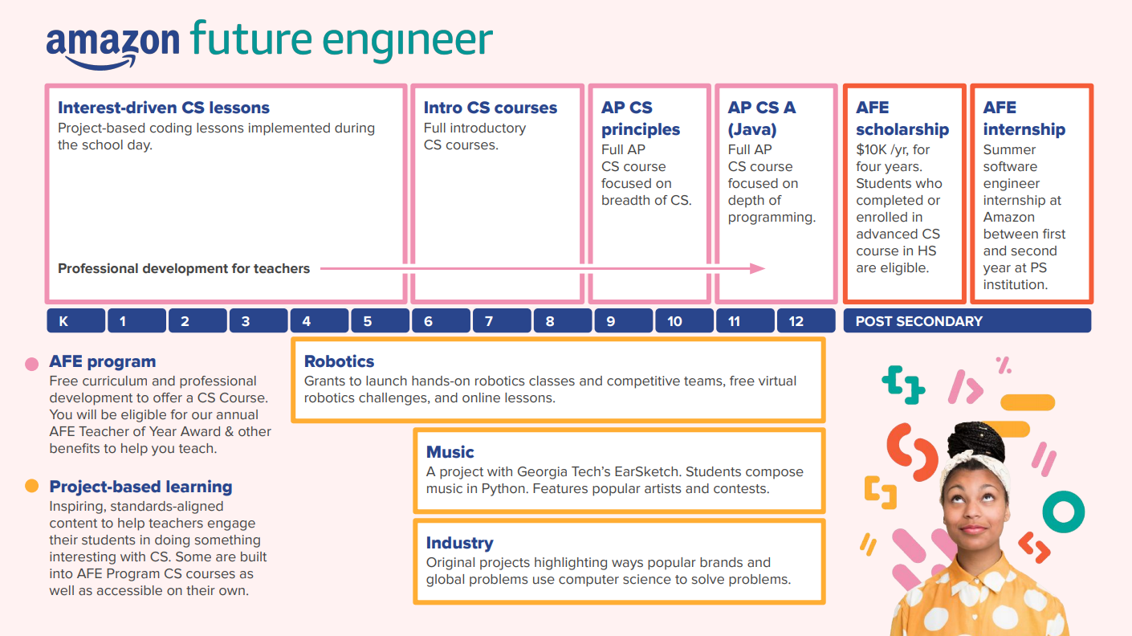

Slide 10
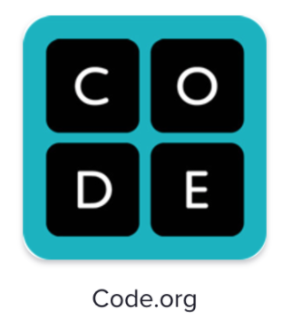
1) Free CS Courses and Teacher Training
Code.org Courses:
Intro to CS
AP CS Principles
AP CS A
Edhesive Courses:
Intro to CS (+EarSketch)
AP CS Principles
AP CS A

Slide 11
Build a full stack future
2) Student Scholarship and Internship
The Amazon Future Engineer Scholarship awards high school students like you a $40,000 scholarship for college, plus a guaranteed paid programming internship at Amazon following their freshman year.
Applications now open!
Check out the eligibility requirements below:
Completed a computer science course in high school
Plan to pursue a bachelor’s degree in computer science
High school senior in the US
US citizen or permanent resident
Applications close February 18th, 2021 so get started now! AmazonFutureEngineer.com/Scholarship
Jessica B Georgia Tech
2023

Slide 12
3) Teacher of the Year
Open to any AFE registered computer science or robotics teacher
$25,000 for the school’s CS or robotics program
$5,000 teacher cash award

Slide 13
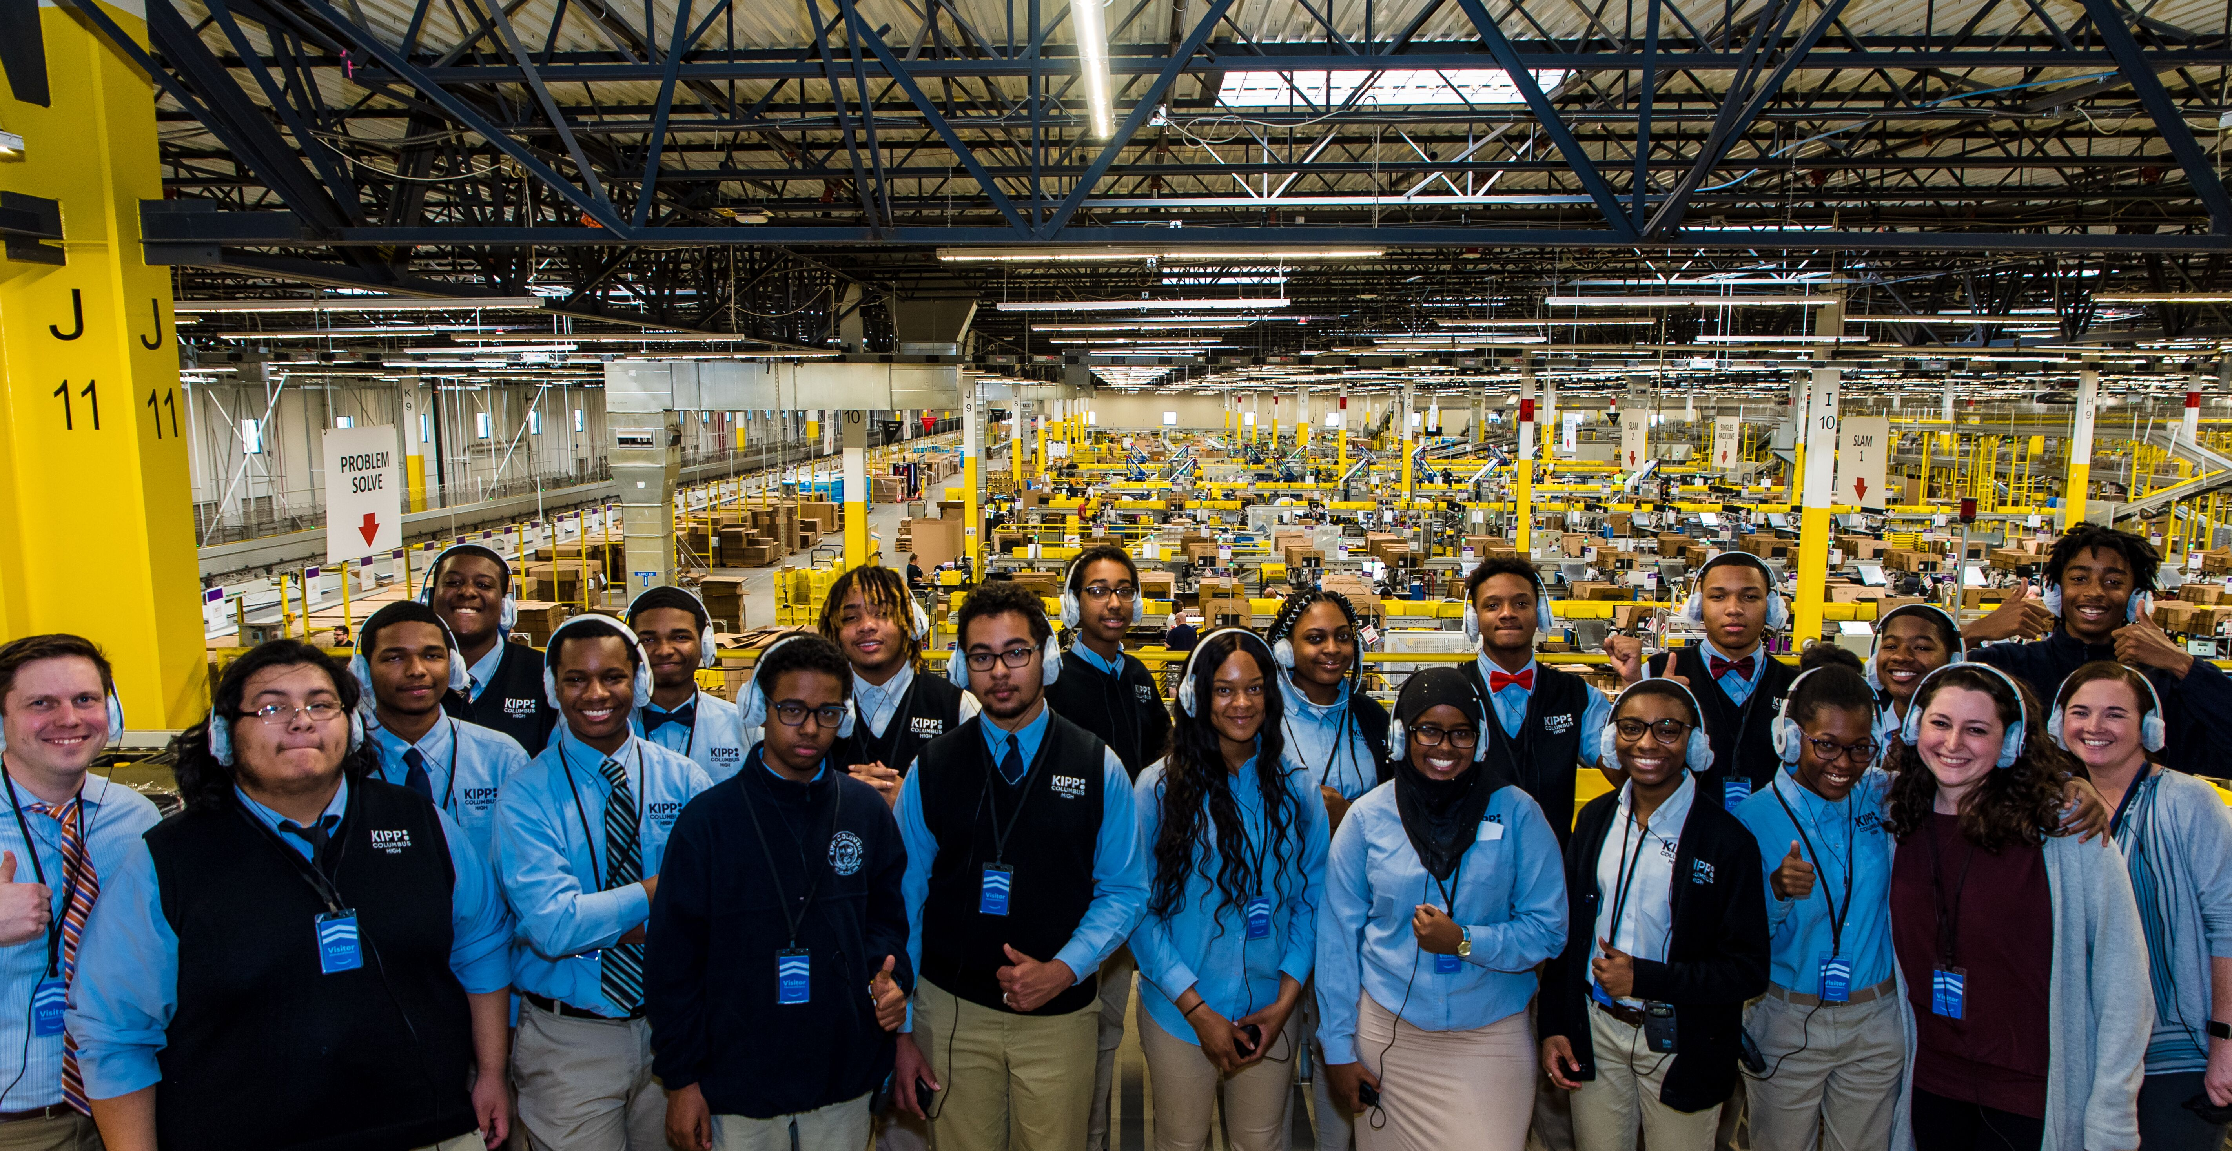
4) Career Inspired Exploration Experiences

Slide 14
Learn how computer science, music, and entrepreneurship can advance racial equity.
Code a remix of Pharrell and Jay-Z’s song Entreprenuer for a chance to win a $5,000 scholarship or $1000 Teacher Award!
Free curriculum & training for teachers
Competition ends June 4th!
Head to amazonfutureengineer.com to start remixing!
Notes:
“Finally, we want to invite you to participate in Amazon Future Engineer’s newest coding competition – Your Voice Is Power! Amazon partnered with Pharrell and Georgia Tech to offer a brand new learning experience for students and teachers that explores how computer science, music, and entrepreneurship can promote racial equity. You can participate as a class (there is free teacher curriculum and training!) or on your own as a student. Five students will win a $5000 scholarship and 5 teachers will win $1000 for excellent instruction. The competition runs now through June 4th – so spread the word and head to AmazonFutureEngineer.com to get started!”

Slide 15
AmazonFutureEngineer.com/CyberRobotics

Slide 16
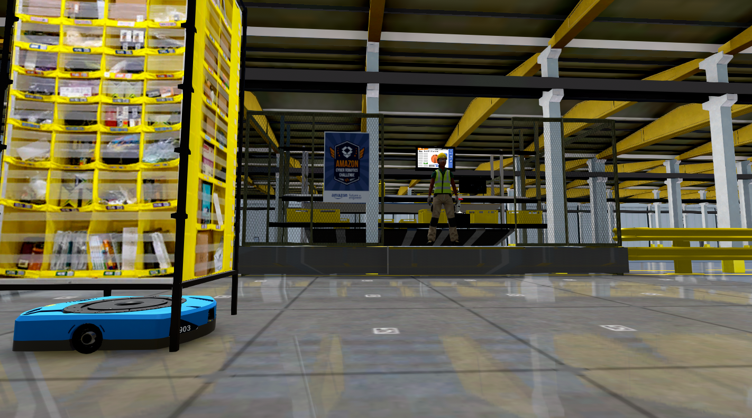
AmazonFutureEngineer.com/CyberRobotics
Notes:
“Also, do you want to learn more about Amazon? You can head to amazonfutureengineer.com/cyberrobotics to complete the Amazon Cyber Robotics Challenge! It’s a 3 hour coding challenge that will show you how Amazon users computer science to deliver customer goods from our Fulfillment centers! You can compete on your own or as a whole class!”

Slide 17
Can you program an Amazon Hercules robot to deliver your friend’s birthday present on time?

Slide 18
What is it?
23 coding missions based on a real world scenario
Coding lessons are split across 3 lessons
Each lesson is designed for a 45 minute session
Built-in videos to provide context and AFE Intern role models
Built-in quizzes
Bonus game unlocked when all missions are completed
Notes:
Great work everyone!

Slide 19
The nuts and bolts
Blockly based drag and drop coding environment
100% browser based, no software installation required
Separate teacher and student login
Includes teacher instructional manual
Dashboard allows teachers to track progress
Works on Chrome books
Not supported on iPads
Monthly $250 Classroom Raffle

Slide 20
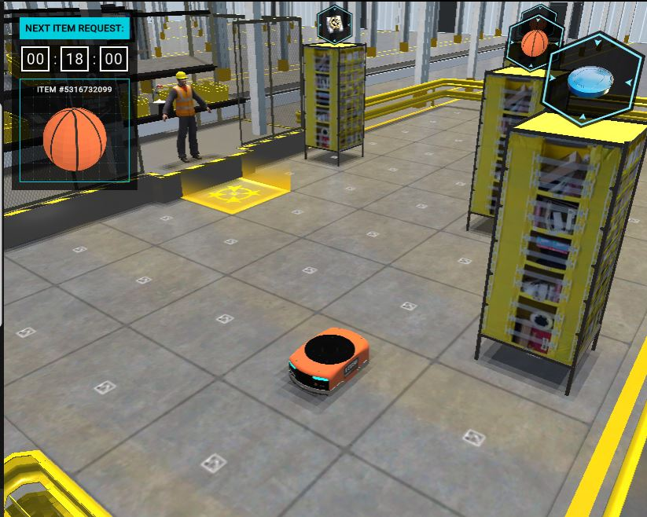
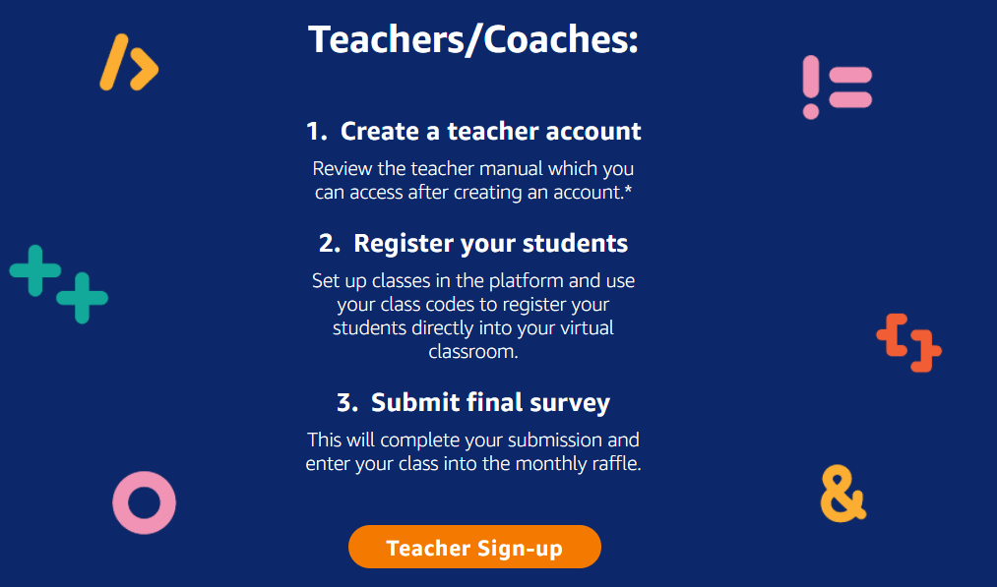
Bring the Challenge to your class:
Head to AmazonFutureEngineer.com to use the challenge with your students!

Slide 21
Free Virtual Robotics with CoderZ:
Notes:
https://play.gocoderz.com/lp/teacher-amazon/?utm_source=AFE_LP&utm_medium=T1_form&utm_campaign=Amazon_Challenge

Slide 22
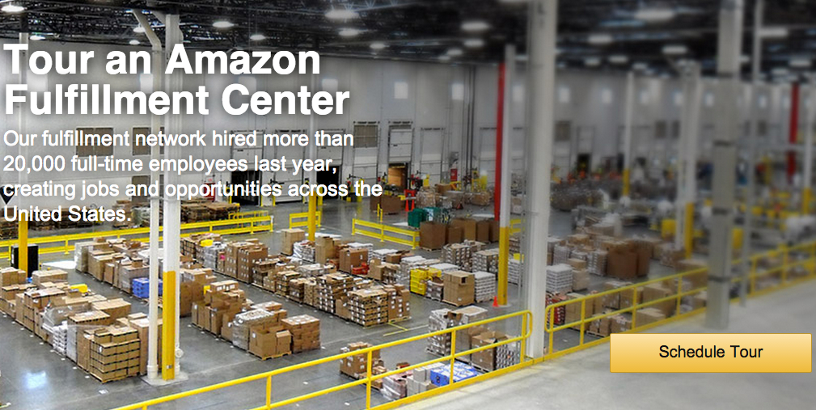
Virtual Field Trips – Later this Spring!

Slide 23
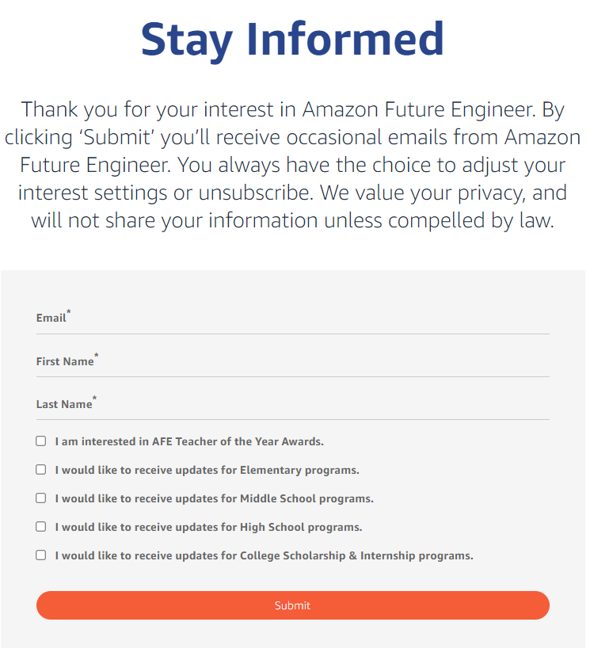
Stay in Touch!
Notes:
https://play.gocoderz.com/lp/teacher-amazon/?utm_source=AFE_LP&utm_medium=T1_form&utm_campaign=Amazon_Challenge

Slide 24
Let’s see the
Cyber Robotics Challenge
in action!
Notes:
Now that you know a little bit about hercules, let me start out by giving everyone some background about Amazon Future Engineer.

Slide 25
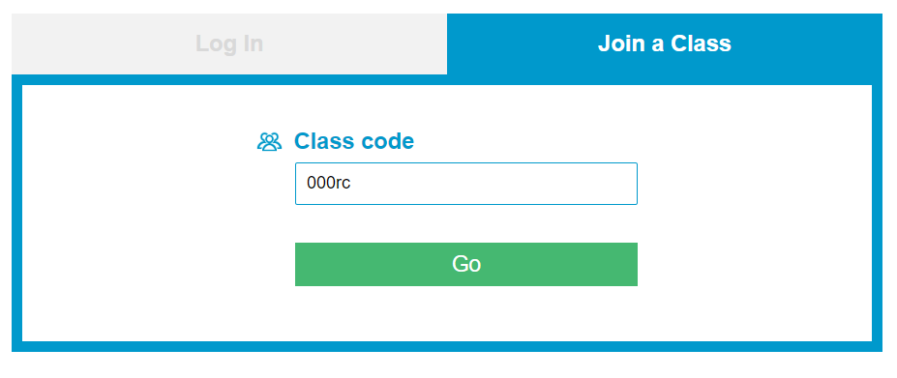
Start playing: play.gocoderz.com
kbsylscpbs
Notes:
Or use this link: https://account.gocoderz.com/join-class/kbsylscpbs

Slide 26
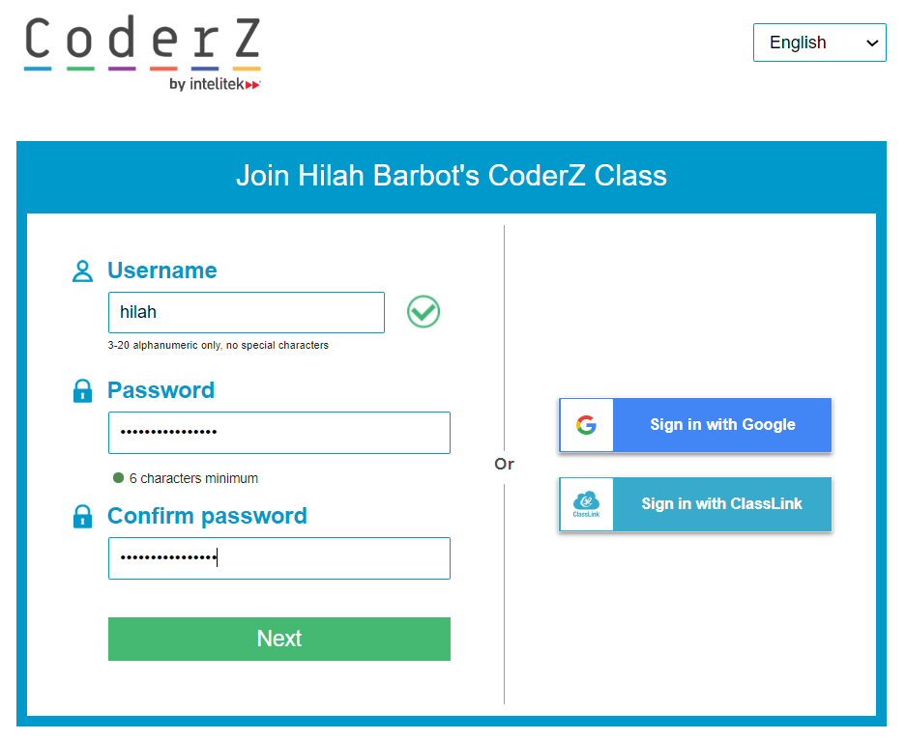
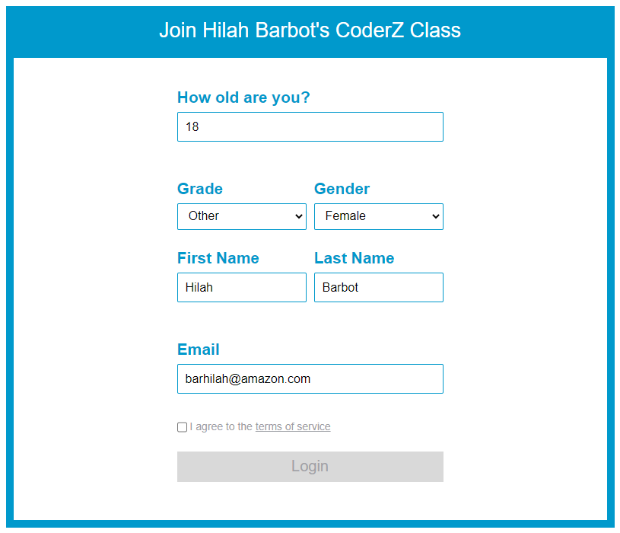
Finish setting up your STUDENT account:
Notes:
https://account.gocoderz.com/join-class/kbsylscpbs

Slide 27
Get Started – One mission at a time!

Slide 28
OR… support our Robotics Trivia Winner as they go through the challenge LIVE!

Slide 29
What are the teacher resources?
Notes:
Before we begin, I want you to meet today’s very special guest – Hercules! Hercules is an amazon robot who helps make sure customers get their order as fast as possible and I want you to know some cool facts about him. Please get your chat boxes ready. I am going to introduce a stat to you and I want you to guess the number!!! Who ever’s closest wins!
Great work everyone!

Slide 30
The teacher login can access:
The ability to create classes and invite students to join using a URL or by sending an email containing link
The ability to control when missions are unlocked
The ability to track mission completion by each student
Suggested solutions
Teacher guide with course outline, lesson plans, FAQ, and glossary
Notes:
Before we begin, I want you to meet today’s very special guest – Hercules! Hercules is an amazon robot who helps make sure customers get their order as fast as possible and I want you to know some cool facts about him. Please get your chat boxes ready. I am going to introduce a stat to you and I want you to guess the number!!! Who ever’s closest wins!
Great work everyone!

Slide 31
What’s in the lesson plans?
Learning goals
Coding blocks used
CoderZ tools used
Timings
Predictive questions
Vocabulary
Reflection Q&A
Extended learning activities
Notes:
Before we begin, I want you to meet today’s very special guest – Hercules! Hercules is an amazon robot who helps make sure customers get their order as fast as possible and I want you to know some cool facts about him. Please get your chat boxes ready. I am going to introduce a stat to you and I want you to guess the number!!! Who ever’s closest wins!
Great work everyone!

Slide 32
Thank you, Everyone!

