Slide 1
Utilizing Career Research to Teach Technology
Ariel Dykstra & Greg Hill
Mount Vernon High School

Slide 2
High School & Beyond Plans
Career Interest Inventory
Career Goals
Skills & Interest Assessment
Educational Goals
4-Year Course Plan
Activity Log/Resume

Slide 3
High School & Beyond Plan
Naviance
Career Cruising

Slide 4
Digital Literacy
Communication Skills
Google
Docs
Slides
Sheets
Leadership
Learning Styles
Career Interests
Resume
Payroll
Budgeting
College Comparisons

Slide 5
Digital
Literacy
Core group of teachers who are focused on understanding the graduation requirement and integrating into curriculum
Advisory
Every teacher was expected to understand the graduation requirement with minimum training and access to necessary resources

Slide 6
Communication Skills
Respectful
Confident
Concise
Assignment
Send an email to your teacher with a professional signature
Advisory Teacher signature

Slide 7
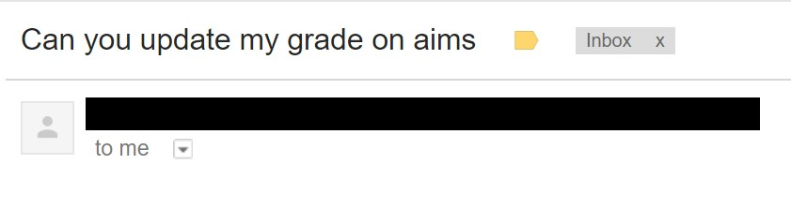
Gmail - Signature
Student Example
Teacher Example

Slide 8
Gmail - Signature Assignment

Slide 9
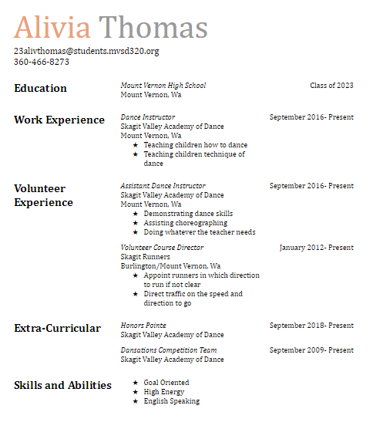
Resume

Slide 10
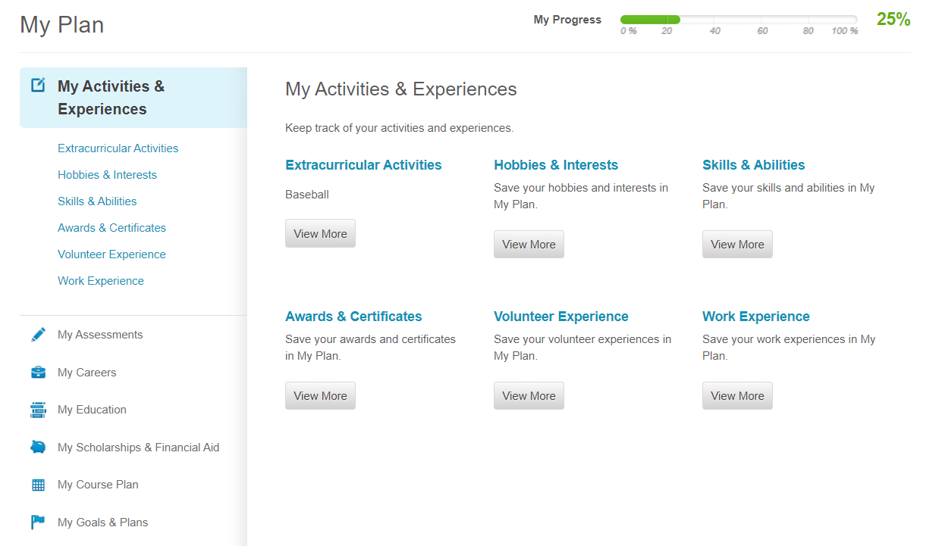
Career Cruising
Navigate website
Organize data
Reflect

Slide 11
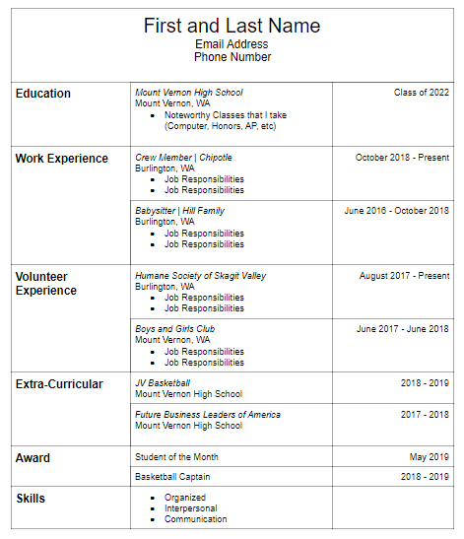
Resume
Tables and Borders
Text Formatting
After Paragraph Spacing
Format Painter
Spell Check

Slide 12
Resume
Skills
Tables and Borders
Text Formatting
Spell Check
Career Focus
Professionalism
Design Consistency
Extra-Curricular
Volunteer Experience

Slide 13
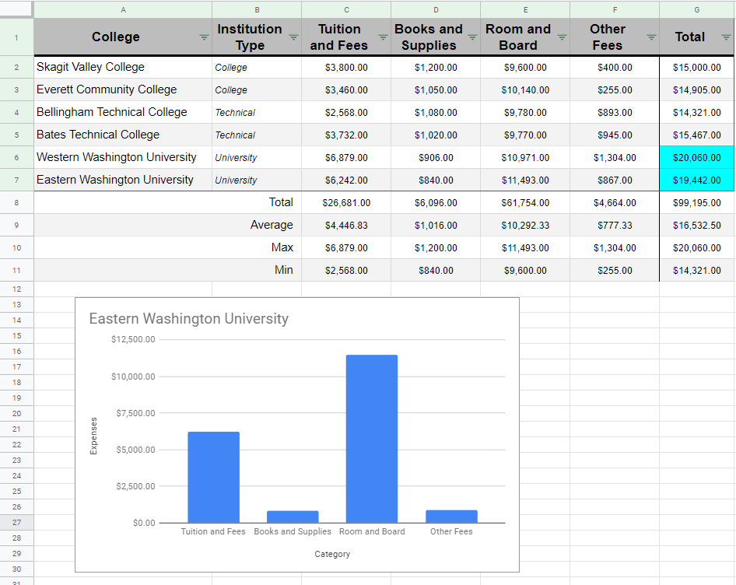
College Comparison

Slide 14
College Comparison
Skills
Borders
Functions
Conditional Formatting
Text Formatting
Wrap Text
Alternating Colors
Career Focus
Research
Organize Data
Evaluate Data

Slide 15
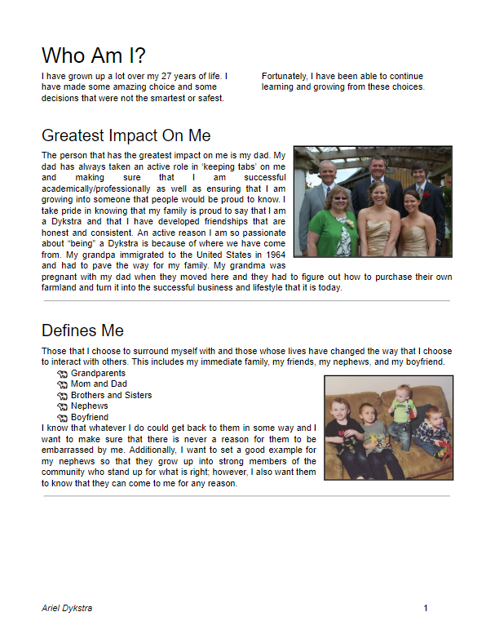
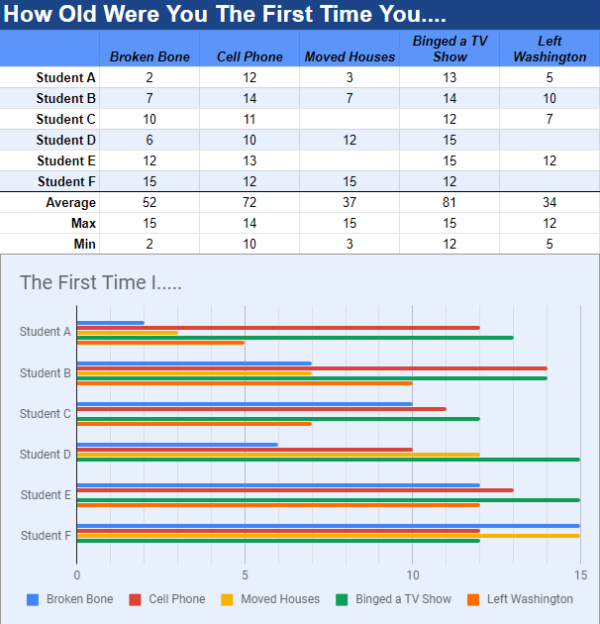
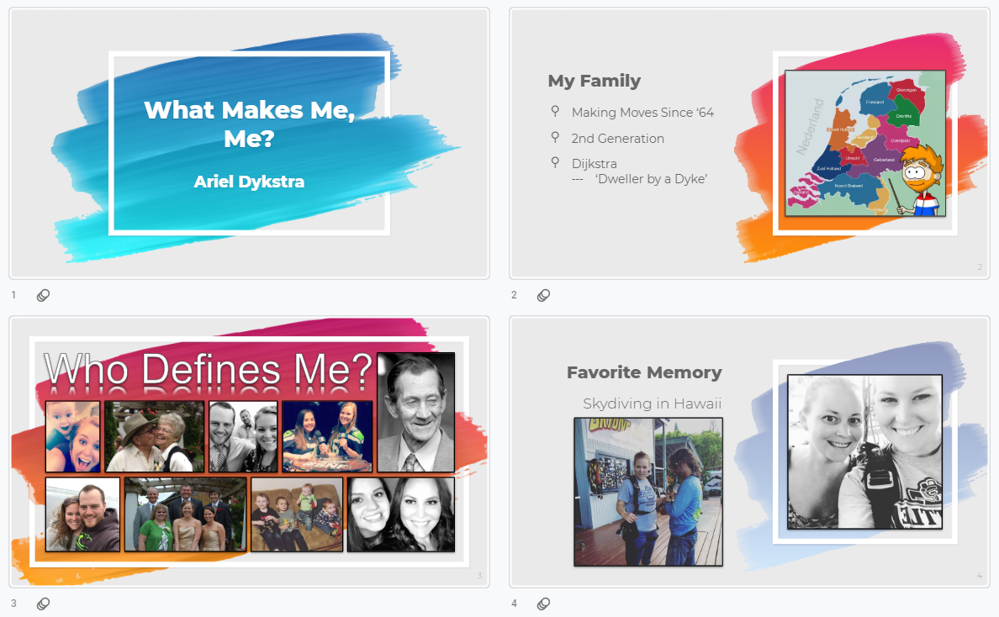
Lifetime Reflection

Slide 16
Lifetime Reflection
Skills
Google Docs
Google Slides
Google Sheets
Career Focus
Design
Organization
Reflecting on Experiences

Slide 17
Leadership

Slide 19
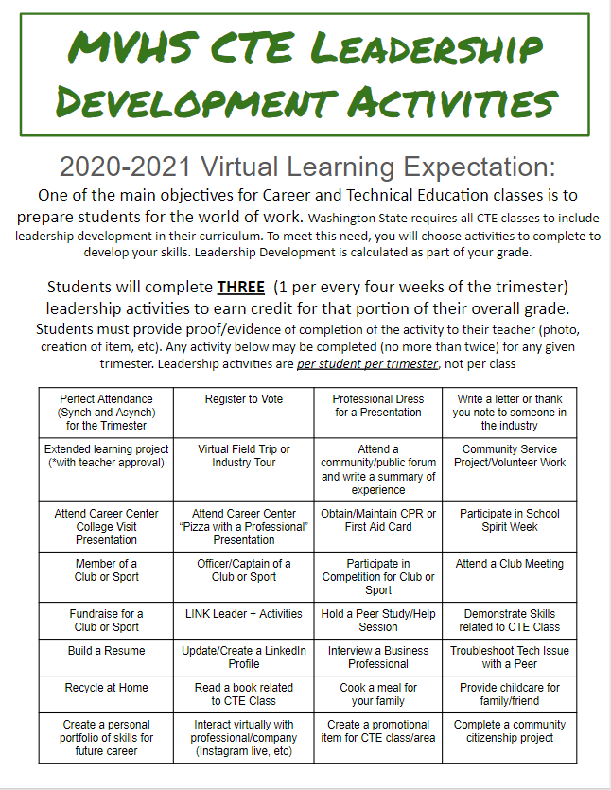
Leadership
Community
Extracurricular
College & Career

Slide 20
Digital Literacy
Communication Skills
Google
Docs
Slides
Sheets
Leadership
Learning Styles
Career Interests
Resume
Payroll
Budgeting
College Comparisons

Slide 21
https://tinyurl.com/y6qc83lp
Link to our current curriculum
* Please make a copy for yourself before making any changes

