Slide 1
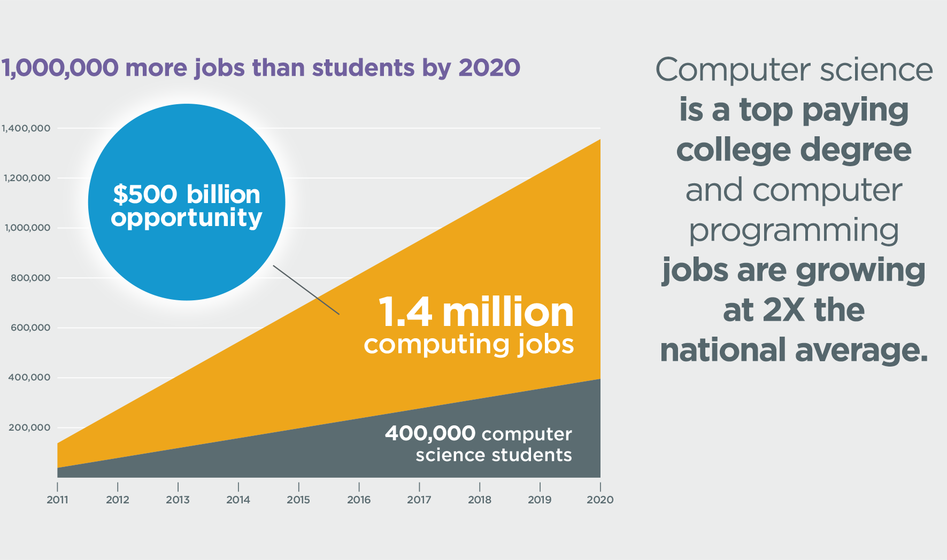
WHY TAKE COMPUTER SCIENCE?

Slide 2
COMPUTER SCIENCE COURSES

Slide 3
CTE - Computer Science Classes
CS NEEDS YOU
Level | Class | Grade | Credit Type | Pre - Rec | Dual Credit | Industry Certification
Entry | Computer Programming (I -II) OR AP Computer Science Principles (A-B) | All | CTE | None | CS College Crd. | MTA - Intro to Programming
Entry | Game Programming | All | CTE / ART | None | None | Unity Certification
Entry | Game Design | All | CTE / ART | None | None | Unity Certification
Adv. | AP Computer Science A (A-C) | All | CTE / 3rd YR MATH | Recommend/ Geometry | CS College Credit | MTA - Intro to Programming
Adv. | Advanced Computer Science Projects | 10-12 | CTE | Recommend /AP Comp Sci | None | MTA - Other Certs
Entry | Cyber Security | All | CTE | None | Network College Credit | Certified Ethical Hacker
Entry - Adv. | Networking [Year 1(A-C), year 2(D-F)] | All | CTE | None | Network College Credit | Comp TIA - Network + , CCNA
WOMEN IN CS
DIVERSITY IN CS

Slide 4
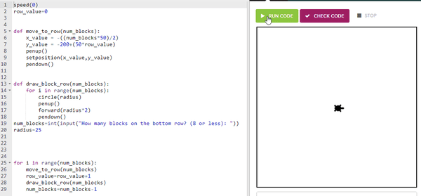
Take Computer Programing I!!!
Credit Type:
CTE / 3rd Yr Math
Grades:
9th - 12th
Learn Python programming language.
Have Questions Ask Mr. Peck keith.peck@rentonschools.us
Skill of the future

Slide 5
Take Computer Programing II!!
Credit Type:
CTE / 3rd Yr Math
Grades:
9th - 12th
Create your own program or app
Develop you 21st Century Skills
Explore you interests
Have Questions Ask Mr. Peck keith.peck@rentonschools.us

Slide 6
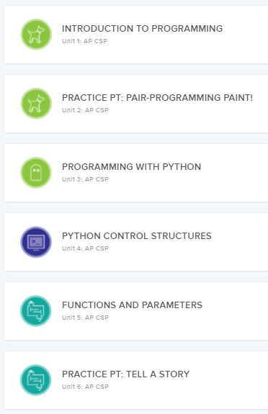
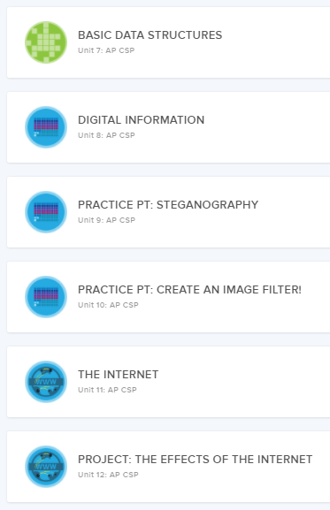
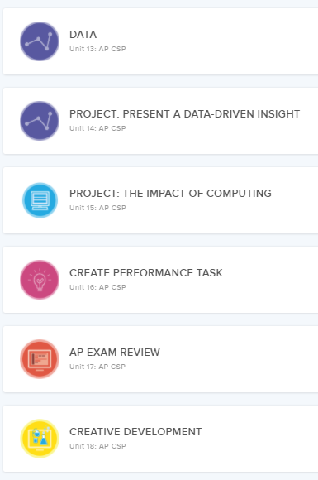
To take AP Computer Science Principles A/B
Sign up for Computer Programming I / II
Credit Type:
CTE
Grades:
9th - 12th
Explore computers through your interest.
Introductory class, no prior computer skills needed.
Have Questions Ask Mr. Peck keith.peck@rentonschools.us

Slide 7
Grades 9- 12
Explore your interest by designing a game!!!
Have Questions Ask Mr. Peck keith.peck@rentonschools.us
Can Repeat Class

Slide 8
Grades 9 - 12 Can Repeat Class
Have Questions Ask Mr. Peck keith.peck@rentonschools.us

Slide 9
Have Questions Ask Mr. Peck keith.peck@rentonschools.us
Credit Type:
CTE / 3rd Yr Math
Grades:
9th - 12th

Slide 10
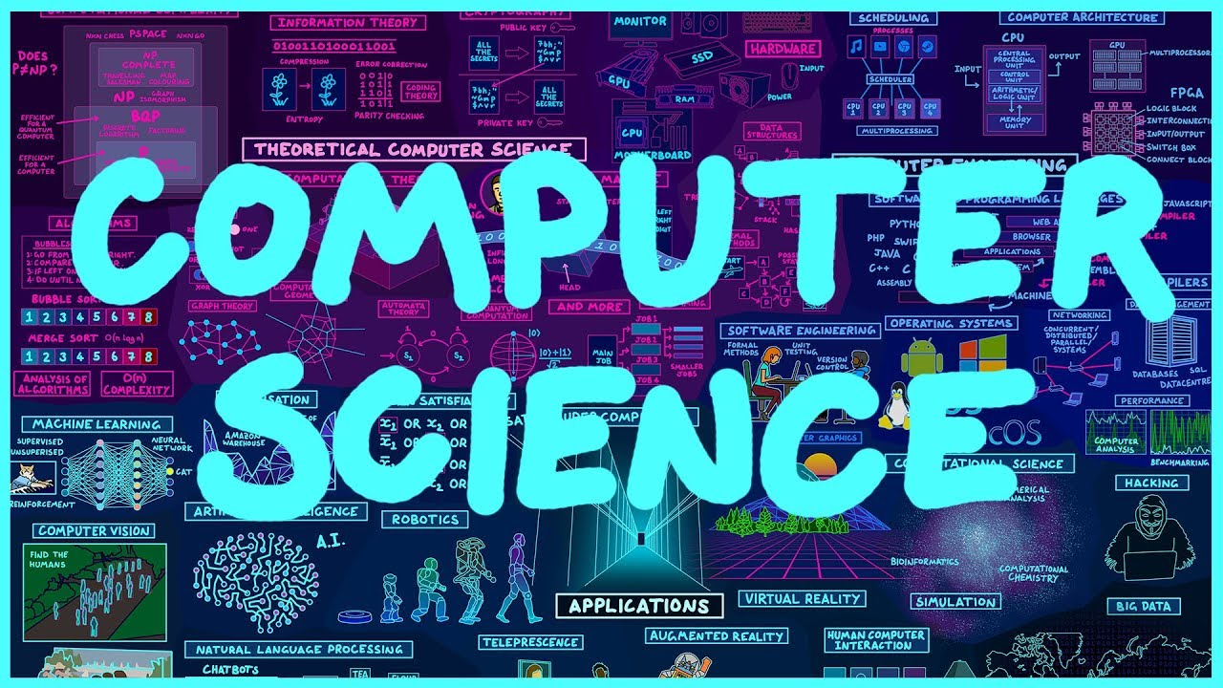
Have Questions Ask Mr. Peck keith.peck@rentonschools.us

Slide 11
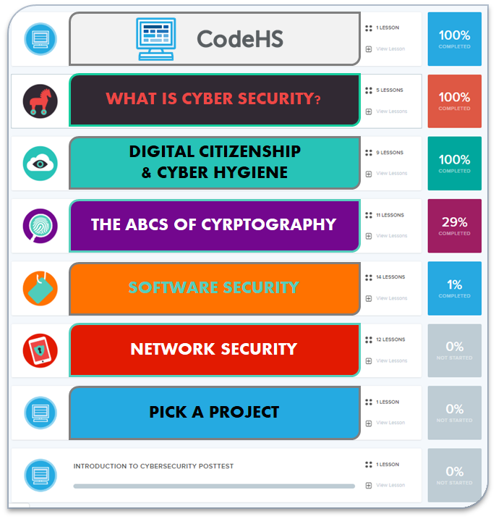
Cyber Security
Have Questions Ask Mr. Peck keith.peck@rentonschools.us
Credit Type:
CTE
Grades:
9th - 12th

Slide 12
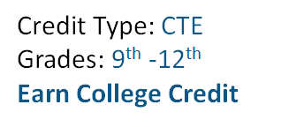
Networking A/B
This course can be used to fulfill the following requirement(s): [ ???? ]
This course can be taken by: [enter grade level(s) here]
Brief Description of Course Here (helpful to include WHAT a student does in this class)
Picture of Work
Embed video
Etc.
Have Questions
Ask Mr. Peck keith.peck@rentonschools.us

Slide 13
Industry Resources
Curriculum Resources
https://www.igniteworldwide.org/
https://www.microsoft.com/en-us/teals
https://www.amazonfutureengineer.com/
https://www.t-mobile.com/business/education
https://edu.google.com/
Development Environments:
https://repl.it/
https://codingrooms.com/
https://www.eclipse.org/downloads/
https://www.jetbrains.com/idea/
https://github.com/
https://glitch.com/
https://scratch.mit.edu/
https://appinventor.mit.edu/

Slide 14
Curriculum Resources
Tutorials and Lessons
https://codehs.com
https://code.org/
https://education.minecraft.net/class-resources/coding-with-minecraft
https://www.csawesome.org/
https://www.csforallwa.org/for-all
https://bootstrapworld.org/
Tutorials and Lessons
https://codehs.com
https://code.org/
https://education.minecraft.net/class-resources/coding-with-minecraft
https://www.csawesome.org/
https://www.csforallwa.org/for-all
https://bootstrapworld.org/

Slide 15
Networking
https://www.csteachers.org/
https://www.cs.washington.edu/outreach/k12
https://www.cwu.edu/computer-science/cwu-first-state-offer-computer-science-teaching-endorsement
https://www.hiddengeniusproject.org/15-tech-organizations-actively-supporting-black-coders/
https://blog.capterra.com/diversity-in-tech-11-associations-and-organizations-for-it-professionals-of-color/
https://www.thecodehouse.org/

