Slide 2
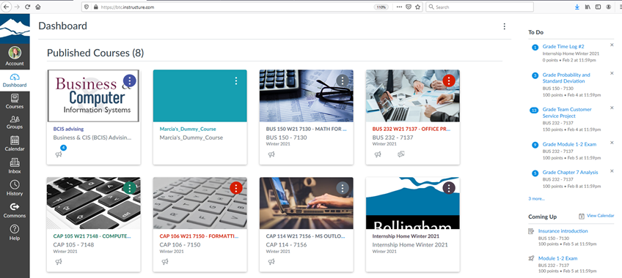
Learning Management Systems
Information
Instruction
Interaction
Assessment
Tips and Tricks
Design
Interaction
Assessment
CANVAS Tips and Tricks

Slide 3
Module organization
Simple and clear
Course Resources module
Publisher integration
Copy previous course
Due dates
Publishing
Accessibility
CANVAS Tips and Tricks DESIGN

Slide 4
Communicate expectations and establish routines
Regular and substantive interaction
Assignments
Quizzes
Discussions
Peer reviews
Conferences
Messages
Announcements
Videos
CANVAS Tips and Tricks INTERACTION

Slide 5
Timely
Rubrics
Quiz grade by question
Quiz analytics
Comments
General box
Quiz answer comments
Rubric comments
In-file comments
Caution with groups
Require notifications settings
CANVAS Tips and Tricks ASSESSMENT

Slide 6
Thank you!
Don’t forget to do your session evaluations!

