Slide 1
Adviser 101: Tips and Tricks For CTS0 Advisers
Peter A. Rustemeyer
425-204-4331 | peter.rustemeyer@rentonschools.us
February 2021 | WBEA Conference

Slide 2
Peter A. Rustemeyer (he/him/his)
Hazen High School | RSD
WSBEA President
WSBEA Rep to WAFBLA BOD
Western Region Local Adviser, FBLA-PBL National BOD
Past state officer (2009-2011)
Past state/national competitor

Slide 3
About: Hazen FBLA
Largest Chapter (122) in 18-19
100+ competitors in about 40 different competitions
10 state officers in 8 consecutive years

Slide 4
Adviser Approach:
LET THE KIDS DO THE WORK!

Slide 5
Chapter Officer Meetings:
August = Training/POW Creation
September = Fundraising/Events
October = Fundraising/FLC
November = Fundraising/Events
December = Fundraising/Events
January= Fundraising/WC
February = Fundraising/State
March = Fundraising/SBLC Prep
April = SBLC
May = Fundraising/NLC/Officer Appointments
June = Officer Elections

Slide 6
Officer Training (August/September):
Three questions every chapter asks:
Fundraising | Chapter Events | Membership Recruitment
Program of Work creation is focused around this area and whatever else they choose.

Slide 7
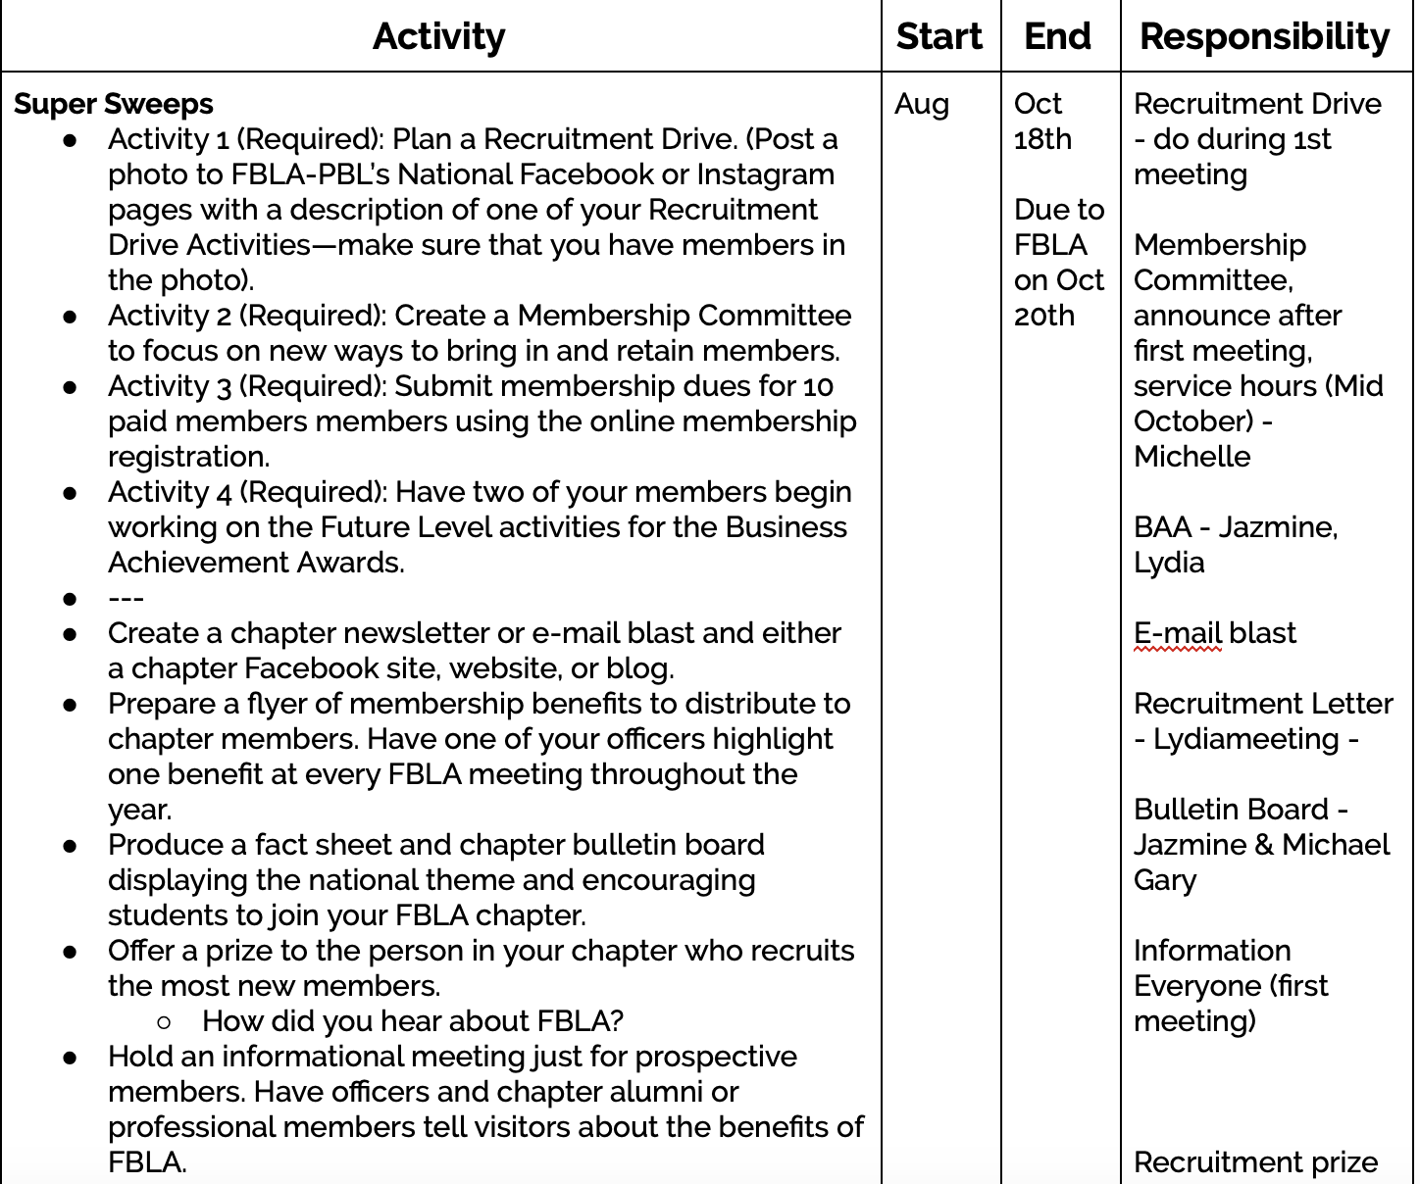
Officer Training Results: POW Training and Committee Program

Slide 8
Fundraising:
Great American Fundraising: fundraiserhelp.com
Concession stands (Seattle area? Husky Concession!)
Buddy Shirts
Local Community Clubs (Rotary, Kiawans, Lions Club, etc.)
Candy Grams, Valentines Roses, etc.

Slide 9
Chapter Meetings:
September = Info/Recruitment
October = FLC/Events
November = FLC/Event finalization
December = Events due dates
January = Winter Conference Prep
February = Winter Conference
March = SBLC Prep
April = SBLC
May = Nationals Prep
June = Officer Elections

Slide 10
Competitive Events:
Online sign up sheet for event selection: Google Forms
“First come, first serve” OR “Event-Off”
FBLA… Remember event restrictions based on membership numbers:
1-30 members= 3 entries
31-40 members= 4 entries
41-50 members= 5 entries
51+ members= 6 entries

Slide 11
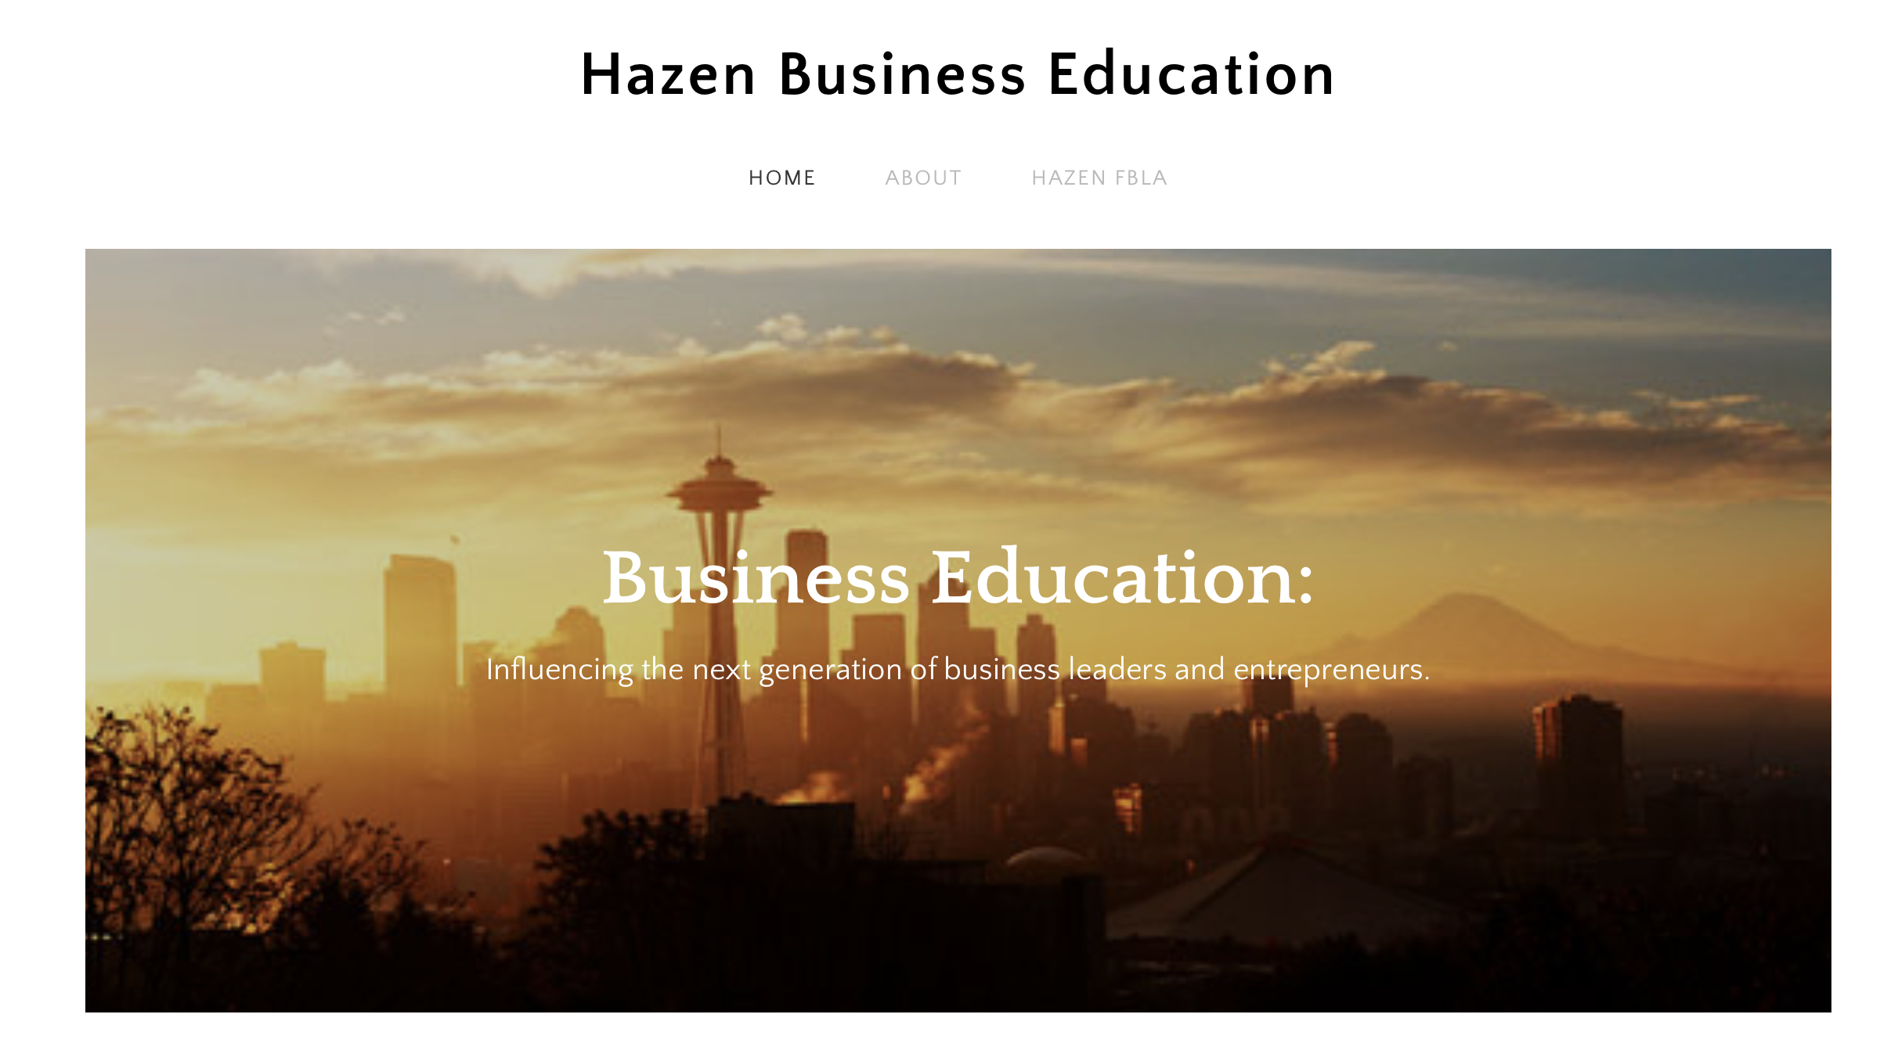
Competitive Events PREP:
Competitive Event nights
Student mentor program
Event due dates
Event Examples

Slide 12
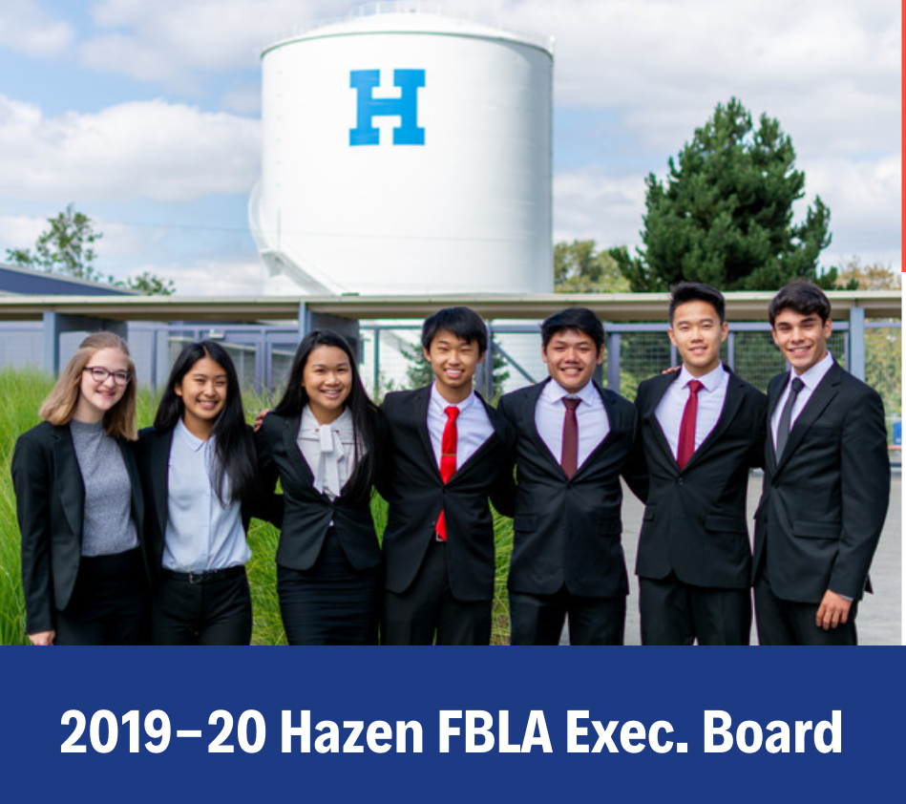
Chapter Officers:
President
Vice President
Secretary
Treasurer
Public Relations Officer
Fundraising Co-Chair

Slide 13
Chapter President Job Duties:
Formal Job Duties
“Other Duties As Assigned”
Preside at meetings
Represent chapter at all events
Appoint committees/chairs
Other duties as assigned
Right hand person
Collect/check accuracy of all data
Manage team
Assist with organization of team and chapter

Slide 14
Chapter Vice President Job Duties:
Formal Job Duties
“Other Duties As Assigned”
Preside in absence of President
Represent chapter at all events
Plan chapter events
Attend all meetings
Other duties as assigned
Competitive event organization
Membership Recruitment

Slide 15
Chapter Secretary Job Duties:
Formal Job Duties
“Other Duties As Assigned”
Record meeting minutes
Represent chapter at all events
Attend all meetings
Other duties as assigned
Membership Recruitment
Membership roster/records

Slide 16
Chapter Treasurer Job Duties:
Formal Job Duties
“Other Duties As Assigned”
Fundraising Paperwork
Work w/ASB for accurate financial records
Represent chapter at all events
Attend all meetings
Other duties as assigned
Track money from fundraising and distribution
Membership Recruitment

Slide 17
Chapter Public Relations Officer Job Duties:
Formal Job Duties
“Other Duties As Assigned”
Manage all social media accounts
Write/compete in LCABR
Represent chapter at all events
Attend all meetings
Other duties as assigned
Membership Recruitment

Slide 18
Chapter Public Relations Officer Job Duties:

Slide 19
Chapter Fundraising Co-Chair Job Duties:
Formal Job Duties
“Other Duties As Assigned”
Plan, organize, and implement fundraisers
Represent chapter at all events
Attend all meetings
Other duties as assigned
Business Liaison
Membership Recruitment

Slide 20
Local Chapter Success Guide
FBLA Contact Information
Adviser/Chapter Resources
Yearly Calendar/Meeting Agendas
Adviser Duties
Chapter Officer Duties

Slide 21
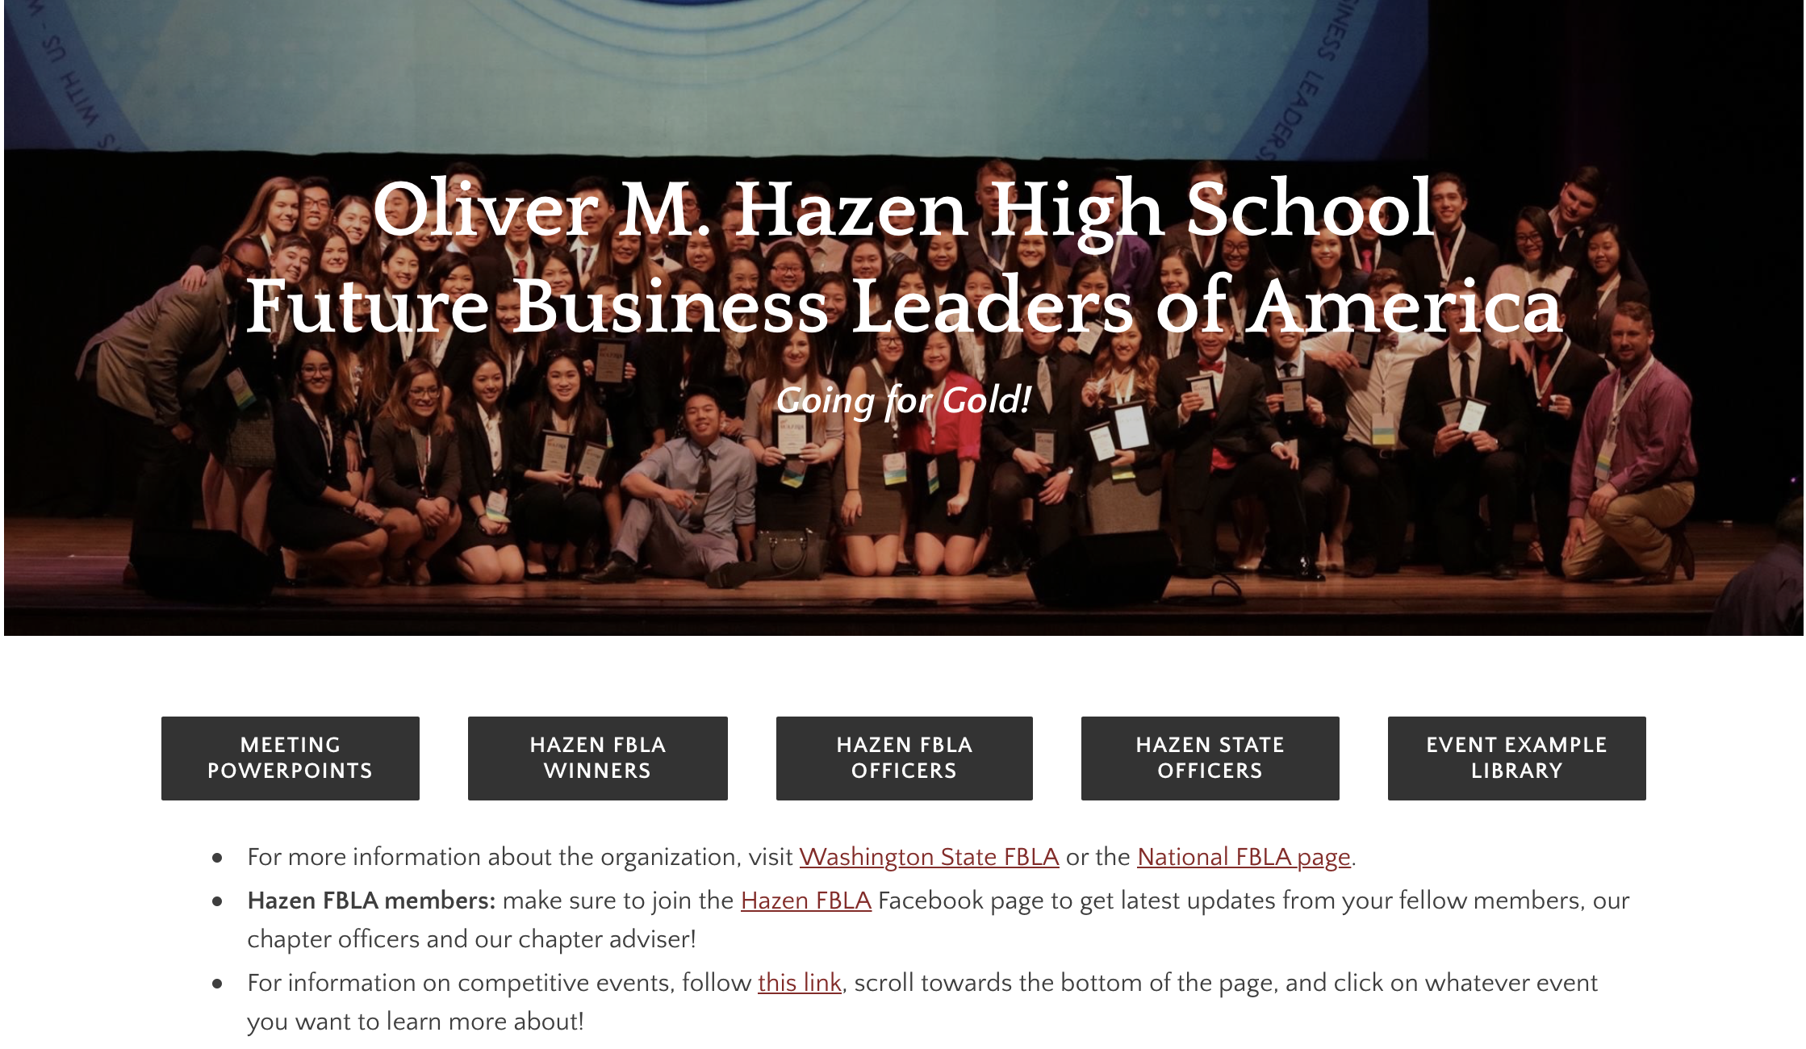
Hazen FBLA Website:
rustybized.weebly.com/hazen-fbla

Slide 22
Chapter Success Guide Additions?
FBLA Contact Information
Adviser/Chapter Resources
Yearly Calendar/Meeting Agendas
Adviser Duties
Chapter Officer Duties
What to add?

Slide 23
Peter A. Rustemeyer Hazen High School | RSD FBLA-PBL National BOD 425-204-4331 | peter.rustemeyer@rentonschools.us

